Slide 1
COMP 4332 / RMBI 4310 Big Data Mining (Spring 2019)
Tutorial 4: Convolutional Neural Network for Text
TA: Xin Liu (xliucr@connect.ust.hk)

Slide 2
Recall tutorial 2
CNN
LeCun, Yann, Léon Bottou, Yoshua Bengio, and Patrick Haffner. "Gradient-based learning applied to document recognition." Proceedings of the IEEE86, no. 11 (1998): 2278-2324.

Slide 3
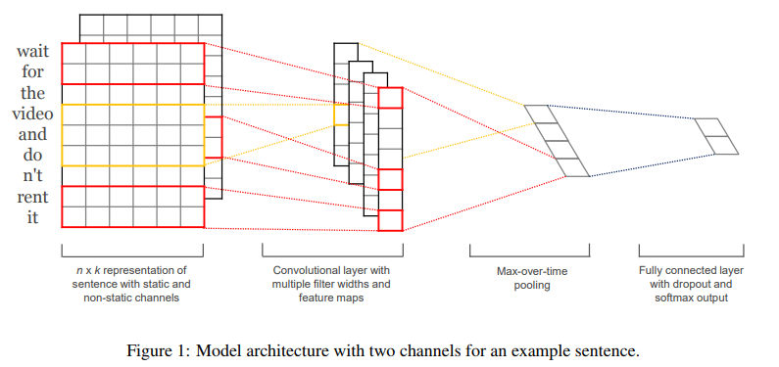
CNN for Text
Kim, Yoon. "Convolutional neural networks for sentence classification." arXiv preprint arXiv:1408.5882 (2014).

Slide 4
Sequential Model
The Sequential model is a linear stack of layers.
But we cannot use the sequential model to handle complex models.
Input
Operation1
Operation2
Operation3
Output
Operation1
Operation2
Input
Operation5
Output
Operation3
Operation4

Slide 5
Building Your Own Model
from keras.models import Model
from keras.layers import Input
x = Input(shape=(30, 40))
x1 = …(x)
x2 = …(x1)
x3 = …(x)
x4 = …(x3)
y = …([x1, x3])
model = Model(x, y)

Slide 6
Building the CNN for Text
Kim, Yoon. "Convolutional neural networks for sentence classification." arXiv preprint arXiv:1408.5882 (2014).

Slide 7
Creating the Input
127 # New model
128 # YOUR CODE HERE
129 x = Input(shape=(input_length, ))

Slide 8
Adding the Embedding Layer
131 # embedding layer and dropout
132 # YOUR CODE HERE
133 e = Embedding(input_dim=input_size, output_dim=embedding_size, input_length=input_length)(x)
134 e_d = Dropout(dropout_rate)(e)

Slide 9
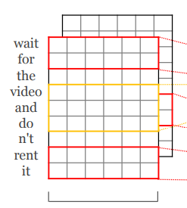
Preparing for CNN
136 # construct the sequence tensor for CNN
137 # YOUR CODE HERE
138 e_d = Reshape((input_length, embedding_size, 1))(e_d)

Slide 10
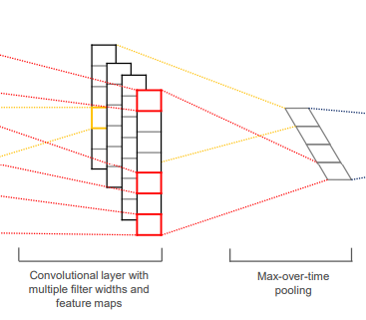
Adding CNN layers
140 # CNN layers
141 conv_blocks = []
142 for kernel_size in kernel_sizes:
143 # YOUR CODE HERE
144 conv = Conv2D(filters=filters, kernel_size=(kernel_size, embedding_size), padding=padding, activation=activation, strides=(strides, strides))(e_d)
145 maxpooling = MaxPool2D(pool_size=((input_length-kernel_size)//strides+1, 1))(conv)
146 faltten = Flatten()(maxpooling)
147 conv_blocks.append(faltten)

Slide 11
Concatenating CNN Results
149 # concatenate CNN results
150 # YOUR CODE HERE
151 c = Concatenate()(conv_blocks) if len(kernel_sizes) > 1 else conv_blocks[0]
152 c_d = Dropout(dropout_rate)(c)

Slide 12
Adding a Dense Layer
154 # dense layer
155 # YOUR CODE HERE
156 d = Dense(hidden_size, activation=activation)(c_d)

Slide 13
Adding the Output Layer
158 # output layer
159 # YOUR CODE HERE
160 y = Dense(output_size, activation='softmax')(d)

Slide 14

Building the Model
162 # build your own model
163 # YOUR CODE HERE
164 model = Model(x, y)

Slide 15
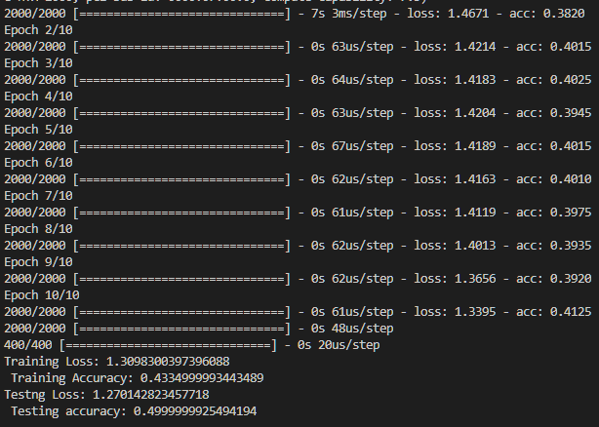
Test Your Code
$ python tut4_skeleton.py
Done!

Slide 16
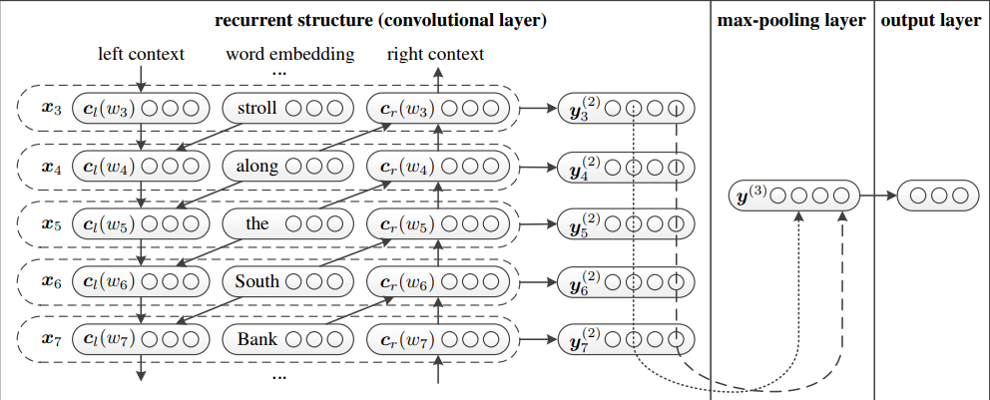
RCNN for Text
Lai, Siwei, Liheng Xu, Kang Liu, and Jun Zhao. "Recurrent convolutional neural networks for text classification." In Twenty-ninth AAAI conference on artificial intelligence. 2015.

Slide 17
Thank You

